Slide 1

Models of Computation
Prepared By by
Pradyumna Bhattarai
Saroj Poudel
Lecturer BIT/BCS Faculty
Texas College

Slide 2
Models of Computation
Random Access Machines
Straight Line Programs and Circuits
Vector Machines
Turing Machines
Pointer Machines
Decision Trees

Slide 3
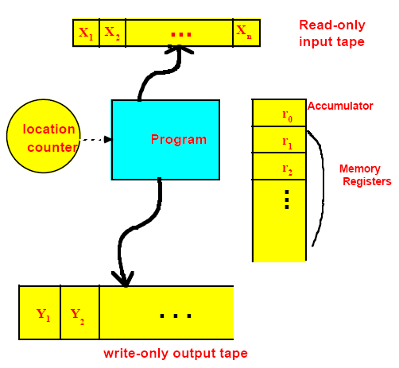
Random Access Machine (RAM)

Slide 4
RAM Assumptions
Each register holds an integer
Program can’t modify itself
Memory instructions involve simple arithmetic
  Addition, subtraction
  Multiplication, division and control states (got, if-then, etc.)

Slide 5
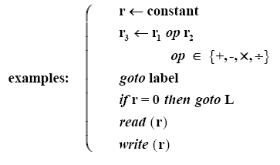
Simplified Program Style

Slide 6
Complexity Measures of Algorithms
Input X
size n=|X|
output
=>
Algorithm A
=>
Time_{A} (X) = time cost of Algorithm A, input X
Space_{A} (X) = space cost of Algorithm A, input X
Note: “time” and “space” depend on machine

Slide 7

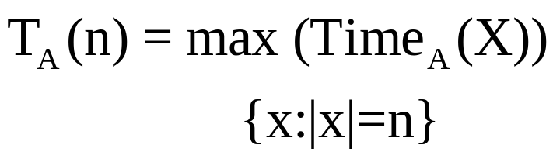
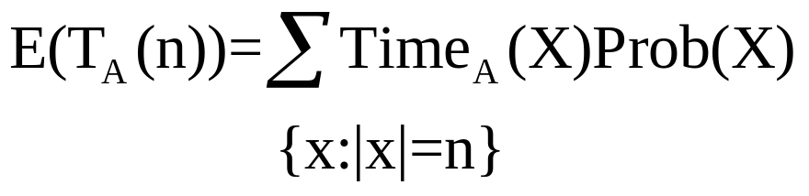
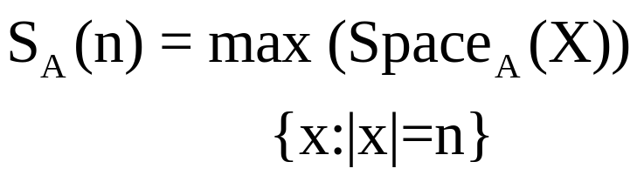
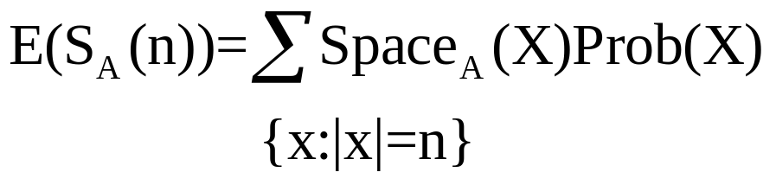
Complexity Measures of Algorithms (cont’d)
Worst case
time complexity
Average case complexity
for random inputs
Worst case
space complexity
Average case complexity
for random inputs

Slide 8
RAM Model…
The RAM (Random Access Machine) model of computation measures the run time of an algorithm by summing up the number of steps needed to execute the algorithm on a set of data.
The RAM model operates by the following principles:
  Basic logical or arithmetic operations (+, *, =, if, call) are considered to be simple operations that take one time step.
  Loops and subroutines are complex operations composed of multiple time steps.
  All memory access takes exactly one time step.

Slide 9
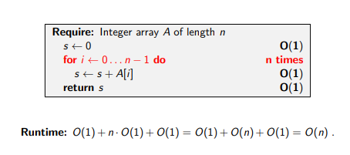
Example
Pseudocode
Cost

Slide 10
Varieties of Computing Machine Models
RAMs
Straight line programs
Circuits
Bit vectors
Lisp machines
…
Turning Machines

Slide 11
Conclusion
There are many possible machine models
Most (but not Nondeterministic) are “constructable” – so might be used if we have efficient algorithms to execute on machines.
New machine models can help us invent new algorithms, and vice versa!

Slide 12
Assignment
Prepare Short Notes on:
Straight Line Programs and Circuits
Vector Machines
Turing Machines
Pointer Machines
Decision Trees

